Slide 1
Chapter 2 Configuration Space
Chapter 3 Rigid-Body Motions
Chapter 4 Forward Kinematics
Chapter 5 Velocity Kinematics and Statics
5.1 Manipulator Jacobian
5.2 Statics of Open Chains
5.3 Singularity Analysis
5.4 Manipulability
Chapter 6 Inverse Kinematics
Chapter 7 Kinematics of Closed Chains
Chapter 8 Dynamics of Open Chains
Chapter 9 Trajectory Generation
Chapter 10 Motion Planning
Chapter 11 Robot Control
Chapter 12 Grasping and Manipulation
Chapter 13 Wheeled Mobile Robots

Slide 2
Important concepts, symbols, and equations
A configuration 𝜃 ∈ ℝ^{n} is singular if rank(J(𝜃)) is less than its maximum rank over all 𝜃.
rank(J_{s}(𝜃)) = rank(J_{b}(𝜃)) ; singularities are independent of frame.
Some common sources of singularities for six-dof spatial open chains:
two collinear revolute joint axes
three coplanar and parallel revolute joint axes
four revolute joint axes intersecting at a common point
four coplanar revolute joints
six revolute joint axes intersecting a common line

Slide 3
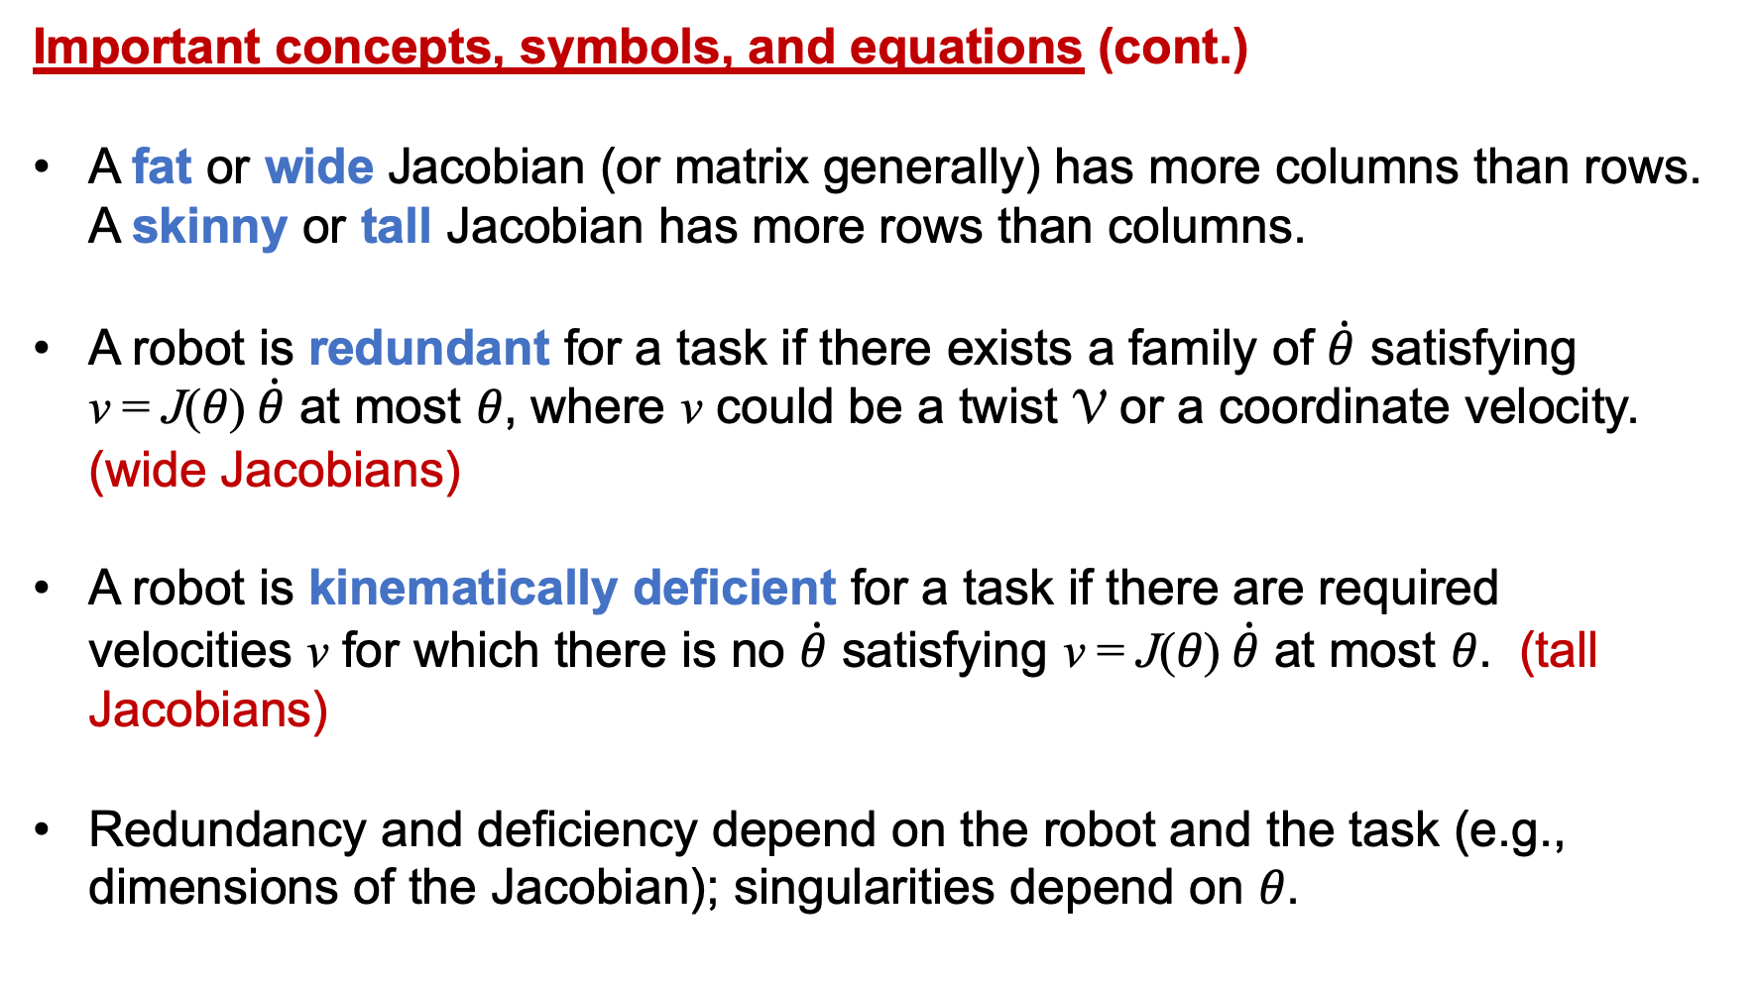
Important concepts, symbols, and equations (cont.)
A fat or wide Jacobian (or matrix generally) has more columns than rows. A skinny or tall Jacobian has more rows than columns.
A robot is redundant for a task if there exists a family of $\dot{θ}$ satisfying v = J(𝜃) $\dot{θ}$ at most 𝜃, where v could be a twist V or a coordinate velocity. (wide Jacobians)
A robot is kinematically deficient for a task if there are required velocities v for which there is no $\dot{θ}$ satisfying v = J(𝜃) $\dot{θ}$ at most 𝜃. (tall Jacobians)
Redundancy and deficiency depend on the robot and the task (e.g., dimensions of the Jacobian); singularities depend on 𝜃.

Slide 4
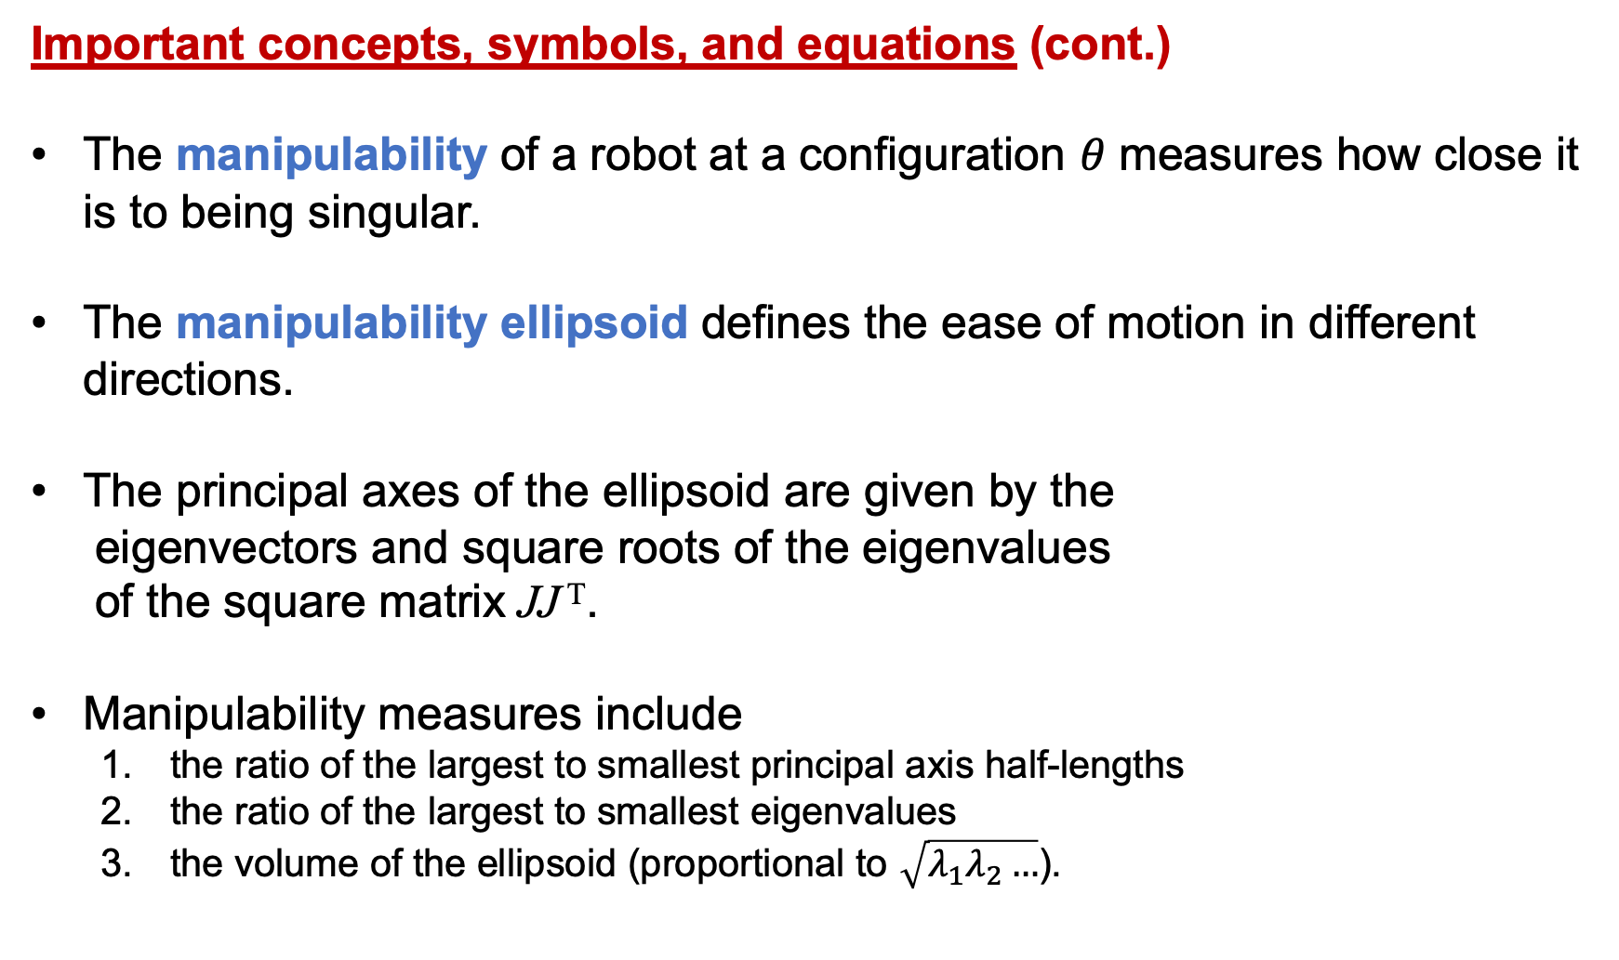
Important concepts, symbols, and equations (cont.)
The manipulability of a robot at a configuration 𝜃 measures how close it is to being singular.
The manipulability ellipsoid defines the ease of motion in different directions.
The principal axes of the ellipsoid are given by the
eigenvectors and square roots of the eigenvalues
of the square matrix JJ ^{T}.
Manipulability measures include
the ratio of the largest to smallest principal axis half-lengths
the ratio of the largest to smallest eigenvalues
the volume of the ellipsoid (proportional to $\sqrt{λ_{1}λ_{2}…}$).

Slide 5
Important concepts, symbols, and equations (cont.)
Split the body Jacobian into angular and linear components to to get angular velocity and linear velocity ellipsoids.

Slide 6
Important concepts, symbols, and equations (cont.)
The principal axes of the force (wrench) ellipsoid are given by the eigenvectors and square roots of the eigenvalues of (JJ ^{T})⁻¹.
The force ellipsoid has the same principal axes as the manipulability ellipsoid, and the principal axis half-lengths are the reciprocal of those of the manipulability ellipsoid.
The product of the volumes of the force and manipulability ellipsoids is constant over 𝜃.

Slide 7



Approximately draw the corresponding
force ellipsoids at the three configurations.
Why use J_{b} instead of J_{s} for
manipulability ellipsoids?

Slide 8
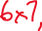

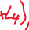
KUKA LBR iiwa 7R robot
If using a twist to represent the e-e velocity,
what are the dimensions of each Jacobian?
For the task of manipulating a rigid body, which
of these is redundant or deficient?
What is the rank of the Jacobian of the iiwa
at its home configuration (shown)?
Adept SCARA RRRP robot
UR5 6R robot

